Slide 1
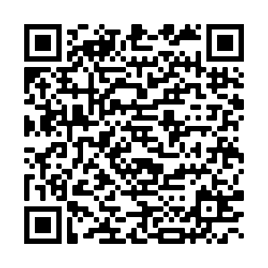
Talking to small business owners
about workplace retirement
3 reasons to offer a retirement benefit
Attract & retain talent
Workplace retirement offsets recruiting costs, turnover, and lower employee productivity due to financial stress
90% of businesses with a 401(k) say retirement benefits helped drive recruitment¹
Save money on taxes
Thanks to SECURE 2.0, employers now have access to tax credits for start-up costs, matching contributions, and auto-enrollment costs.
Nearly 48% of small employers doubt their ability to afford a retirement plan, but tax credits can substantially reduce costs
Build long-term wealth
Business owners can offer employees a path to long-term wealth through a retirement plans with bundled tools to reduce financial stress
83% of small business owners know they should be saving more for retirement²
Debunking common myths about 401(k) plans
Myth | Reality
Business owners need investment knowledge to advise employees | False. Participant support should be provided by the plan provider. In some cases, like pooled employer plans, the investment lineup is pre-selected.
Owners don’t need a retirement plan; they can just sell their business | Not likely. Small business owners frequently sacrifice retirement security to sustain their businesses. In surveys, 21% used retirement savings for their business, and 40% lack confidence in retiring before age 65.
My business is too small to offer workplace retirement | Not true. 63% of small business owners lack the resources for retirement plan administration. Pooled employer plans were designed to address this, making 401(k)s accessible to small businesses with limited resources
Employees just want more pay; they don’t value having a retirement benefit | Not necessarily. Competitive pay matters, but 48% of departing employees reported lack of retirement benefits influenced their decision to leave.³
Fidelity Advantage 401(k)SM
A 401(k) plan built for small businesses.
Questions?
FidelityAdvantageInfo@fmr.com
^{1,2,3} SCORE Small Business Retirement – Investing in Your Future, December, 2022
Fidelity Investments Institutional Operations Company LLC
245 Summer Street, Boston, MA 02210
1108205.1.0

